Slide 1

BCA Ist Semester
PROBLEM SOLVING USING COMPUTER
Course Code: BCAC 0018
Presented by:
Mr.Shivank Chauhan
Dept. Of CEA
GLA University, Mathura

Slide 2
2. Minicomputers
Multi-user systems.
High processing speed and high storage capacity than the microcomputers.
No of users 4–200.
The users can access the minicomputer through their PCs or terminal.
They are used for real-time applications in industries, research centers,
Example: PDP 11, IBM (8000 series).

Slide 3
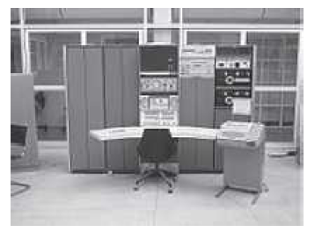
Minicomputers

Slide 4
3. Mainframe Computers
Multi-user / multi-programming / and high performance computers.
High speed / large storage capacity
Used in centralized databases.
The user accesses the mainframe computer via a terminal that may be a dumb terminal, an intelligent terminal or a PC.
Mainframe computers are used in organizations like banks or companies, where many people require frequent access to the same data.
Examples: are CDC 6600 and IBM ES000 series.

Slide 5
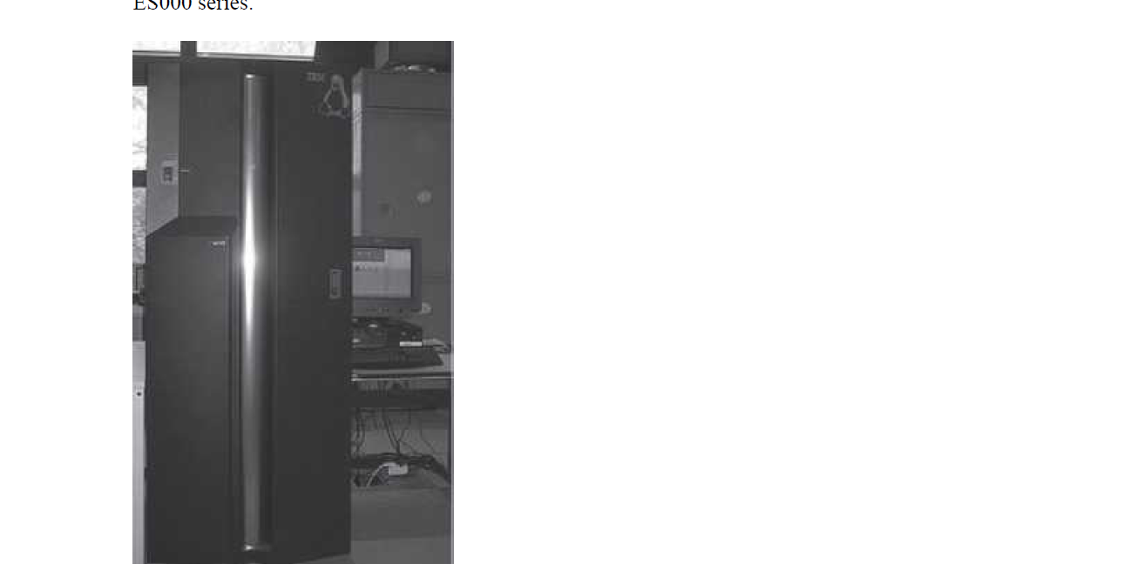

Slide 6
4. Supercomputers
Fastest and the most expensive machines.
High processing speed.
The speed of a supercomputer is measured in FLOPS (FLoating point Operations Per Second).
Supercomputers are built by interconnecting thousands of processors that can work in parallel.
Used for highly calculation-intensive tasks, such as, weather forecasting, biological research, nuclear research and aircraft design.
Examples:- IBM Roadrunner, IBM Blue gene and Intel ASCI red.
PARAM is a series of supercomputer assembled in India by C-DAC (Center for Development of Advanced Computing), in Pune. PARAM Padma is the latest machine in this series. The peak computing power of PARAM Padma is 1 Tera FLOP (TFLOP).
Tainhe-2 (Milky way-2) China (33.86 TFLOP)
Titan- America (10 TFLOP)

Slide 7
